Slide 1

CSE 2218: Data Structures and Algorithms II Laboratory
Sherajul Arifin
Lecturer, Department of Computer Science and Engineering,
United International University

Slide 2
Dynamic Programming

Slide 3
Dynamic Programming
Dynamic programming, popularly known as DP, is a method of solving problems by —
breaking them down into simple, overlapping subproblems
solving each of the subproblems only once,
storing the solutions to the subproblems that are solved to avoid redundant computations.

Slide 4
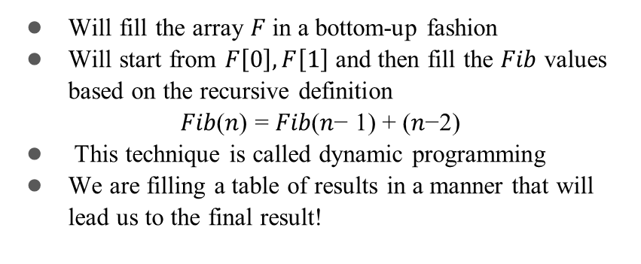
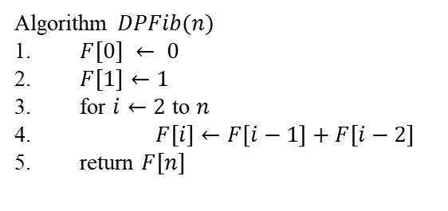
Fibonacci

Slide 5
Memoization (Top-Down)
#include <bits/stdc++.h>
using namespace std;
int fibMemo(int n, vector<int>& dp) {
if(n <= 1) return n;
if(dp[n] != -1) return dp[n];
return dp[n] = fibMemo(n-1, dp) + fibMemo(n-2, dp);
}
int main() {
int n = 10;
vector<int> dp(n+1, -1);
cout << fibMemo(n, dp) << endl;
}

Slide 6
Tabulation (Bottom-Up)
#include <bits/stdc++.h>
using namespace std;
int fibDP(int n) {
vector<int> dp(n+1);
dp[0]=0; dp[1]=1;
for(int i=2;i<=n;i++)
dp[i] = dp[i-1] + dp[i-2];
return dp[n];
}
int main() {
int n = 10;
cout << fibDP(n)<< endl;
}

Slide 7
Coin change problem
Coins = [1, 5, 6, 8], Amount = 11
0 | 1 | 2 | 3 | 4 | 5 | 6 | 7 | 8 | 9 | 10 | 11
0 | ∞ | ∞ | ∞ | ∞ | ∞ | ∞ | ∞ | ∞ | ∞ | ∞ | ∞

Slide 8
Coin change problem
Coins = [1, 5, 6, 8], Amount = 11
0 | 1 | 2 | 3 | 4 | 5 | 6 | 7 | 8 | 9 | 10 | 11
0 | 1 | ∞ | ∞ | ∞ | ∞ | ∞ | ∞ | ∞ | ∞ | ∞ | ∞
min(dp[1-1] + 1, dp[1]) = min(1, ∞) = 1
Nothing for coins: [5, 6, 8]

Slide 9
Coin change problem
Coins = [1, 5, 6, 8], Amount = 11
0 | 1 | 2 | 3 | 4 | 5 | 6 | 7 | 8 | 9 | 10 | 11
0 | 1 | 2 | ∞ | ∞ | ∞ | ∞ | ∞ | ∞ | ∞ | ∞ | ∞
min(dp[2-1] + 1, dp[2]) = min(2, ∞) = 2
Nothing for coins: [5, 6, 8]

Slide 10
Coin change problem
Coins = [1, 5, 6, 8], Amount = 11
0 | 1 | 2 | 3 | 4 | 5 | 6 | 7 | 8 | 9 | 10 | 11
0 | 1 | 2 | 3 | ∞ | ∞ | ∞ | ∞ | ∞ | ∞ | ∞ | ∞
min(dp[3-1] + 1, dp[3]) = min(3, ∞) = 3
Nothing for coins: [5, 6, 8]

Slide 11
Coin change problem
Coins = [1, 5, 6, 8], Amount = 11
0 | 1 | 2 | 3 | 4 | 5 | 6 | 7 | 8 | 9 | 10 | 11
0 | 1 | 2 | 3 | 4 | ∞ | ∞ | ∞ | ∞ | ∞ | ∞ | ∞
min(dp[4-1] + 1, dp[4]) = min(4, ∞) = 4
Nothing for coins: [5, 6, 8]

Slide 12
Coin change problem
Coins = [1, 5, 6, 8], Amount = 11
0 | 1 | 2 | 3 | 4 | 5 | 6 | 7 | 8 | 9 | 10 | 11
0 | 1 | 2 | 3 | 4 | 1 | ∞ | ∞ | ∞ | ∞ | ∞ | ∞
min(dp[5-1] + 1, dp[5]) = min(5, ∞) = 5
min(dp[5-5] + 1, dp[5]) = min(1, ∞) = 1
Nothing for coins: [6, 8]

Slide 13
Coin change problem
Coins = [1, 5, 6, 8], Amount = 11
0 | 1 | 2 | 3 | 4 | 5 | 6 | 7 | 8 | 9 | 10 | 11
0 | 1 | 2 | 3 | 4 | 1 | 1 | ∞ | ∞ | ∞ | ∞ | ∞
min(dp[6-1] + 1, dp[6]) = min(2, ∞) = 2
min(dp[6-5] + 1, dp[6]) = min(2, ∞) = 2
min(dp[6-6] + 1, dp[6]) = min(1, ∞) = 1
Nothing for coins: [8]

Slide 14
Coin change problem
Coins = [1, 5, 6, 8], Amount = 11
0 | 1 | 2 | 3 | 4 | 5 | 6 | 7 | 8 | 9 | 10 | 11
0 | 1 | 2 | 3 | 4 | 1 | 1 | 2 | ∞ | ∞ | ∞ | ∞
min(dp[7-1] + 1, dp[7]) = min(2, ∞) = 2
min(dp[7-5] + 1, dp[7]) = min(3, ∞) = 3
min(dp[7-6] + 1, dp[7]) = min(2, ∞) = 2
Nothing for coins: [8]

Slide 15
Coin change problem
Coins = [1, 5, 6, 8], Amount = 11
0 | 1 | 2 | 3 | 4 | 5 | 6 | 7 | 8 | 9 | 10 | 11
0 | 1 | 2 | 3 | 4 | 1 | 1 | 2 | 1 | ∞ | ∞ | ∞
min(dp[8-1] + 1, dp[8]) = min(3, ∞) = 3
min(dp[8-5] + 1, dp[8]) = min(4, ∞) = 4
min(dp[8-6] + 1, dp[8]) = min(3, ∞) = 3
min(dp[8-8] + 1, dp[8]) = min(1, ∞) = 1

Slide 16
Coin change problem
Coins = [1, 5, 6, 8], Amount = 11
0 | 1 | 2 | 3 | 4 | 5 | 6 | 7 | 8 | 9 | 10 | 11
0 | 1 | 2 | 3 | 4 | 1 | 1 | 2 | 1 | 2 | ∞ | ∞
min(dp[9-1] + 1, dp[9]) = min(2, ∞) = 2
min(dp[9-5] + 1, dp[9]) = min(5, ∞) = 5
min(dp[9-6] + 1, dp[9]) = min(4, ∞) = 4
min(dp[9-8] + 1, dp[9]) = min(2, ∞) = 2

Slide 17
Coin change problem
Coins = [1, 5, 6, 8], Amount = 11
0 | 1 | 2 | 3 | 4 | 5 | 6 | 7 | 8 | 9 | 10 | 11
0 | 1 | 2 | 3 | 4 | 1 | 1 | 2 | 1 | 2 | 2 | ∞
min(dp[10-1] + 1, dp[10]) = min(3, ∞) = 3
min(dp[10-5] + 1, dp[10]) = min(2, ∞) = 2
min(dp[10-6] + 1, dp[10]) = min(5, ∞) = 5
min(dp[10-8] + 1, dp[10]) = min(3, ∞) = 3

Slide 18
Coin change problem
Coins = [1, 5, 6, 8], Amount = 11
0 | 1 | 2 | 3 | 4 | 5 | 6 | 7 | 8 | 9 | 10 | 11
0 | 1 | 2 | 3 | 4 | 1 | 1 | 2 | 1 | 2 | 2 | 2
min(dp[11-1] + 1, dp[11]) = min(3, ∞) = 3
min(dp[11-5] + 1, dp[11]) = min(2, ∞) = 2
min(dp[11-6] + 1, dp[11]) = min(2, ∞) = 2
min(dp[11-8] + 1, dp[11]) = min(4, ∞) = 4

Slide 19
The famous knapsack problem
There are two versions of the problem:
  (1) “0-1 knapsack problem”
  Items are indivisible: you either take an item or not.
  Solved with dynamic programming.
  (2) “Fractional knapsack problem”
  Items are divisible: you can take any fraction of an item.
  Solved with a greedy algorithm.

Slide 20
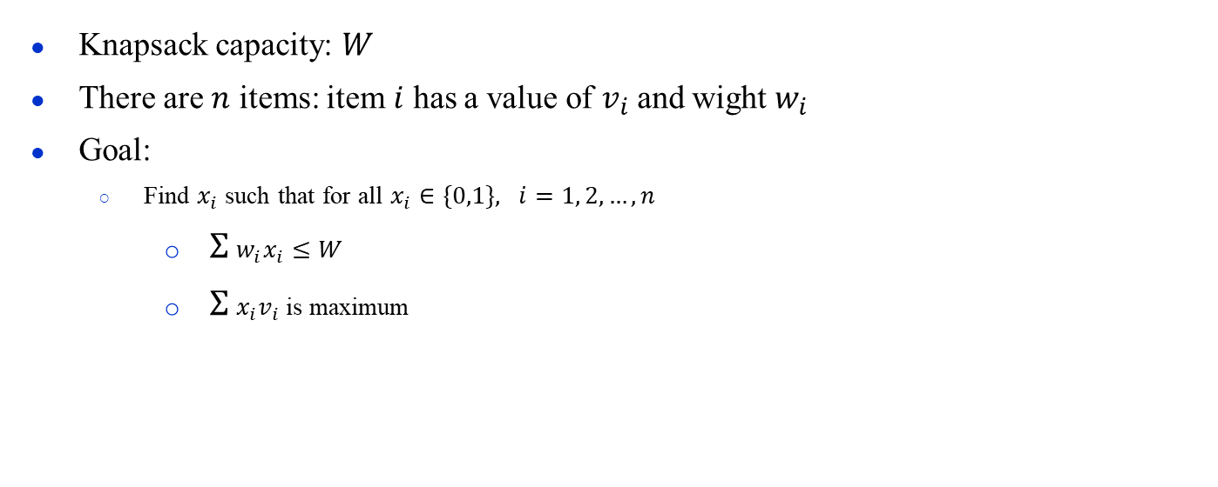
0-1 Knapsack problem

Slide 21
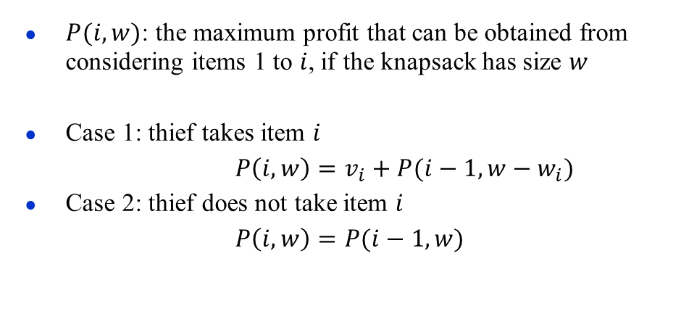
0-1 Knapsack problem
Item | Weight | Value
1 | 2 | 12
2 | 1 | 10
3 | 3 | 20
4 | 2 | 15

Slide 22
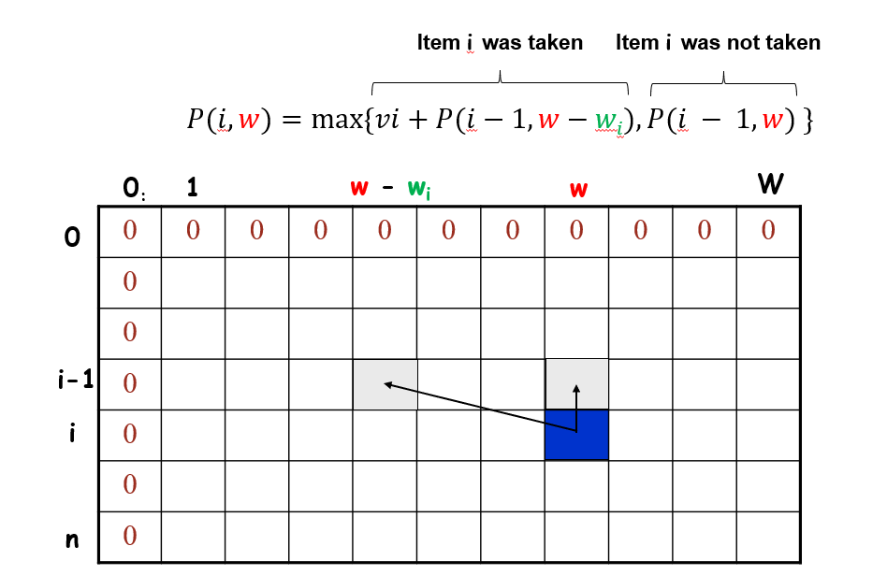
0-1 Knapsack problem

Slide 23
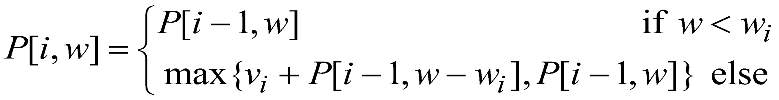
0-1 Knapsack problem
The best subset that has the total weight w, either contains item i or not.
First case: w <w_{i}. Item i can’t be part of the solution, since if it was, the total weight would be > w, which is unacceptable.
Second case: w >= w_{i}. Then the item i can be in the solution, and we choose the case with greater value.

Slide 24
Rod Cutting
Given a rod of length n inches and a table of prices p_{i} for i = 1, 2, …, n, determine the maximum revenue obtainable by cutting up the rod and selling the pieces. Note that if the price pn for a rod of length n is large enough, an optimal solution may require no cutting at all.
Your task is to solve the rod cutting problem using dynamic programming. Print the maximum revenue and length of each piece.
Length i |  | 1 | 2 | 3 | 6 | 10
Price p_{i} |  | 2 | 5 | 10 | 13 | 25

Slide 25
Any Questions?

Slide 26
Thank You!

